Slide 1
NBKR INSTITUTE OF SCIENCE AND TECHNOLOGY
TEAMUP
SMART HACKATHON TEAM FINDER
A structured way to discover the right team
for the right event.
24KB1A05U7
24KB1A05T3
24KB1A05BA
24KB1A05P0
24KB1A05AJ

Slide 2
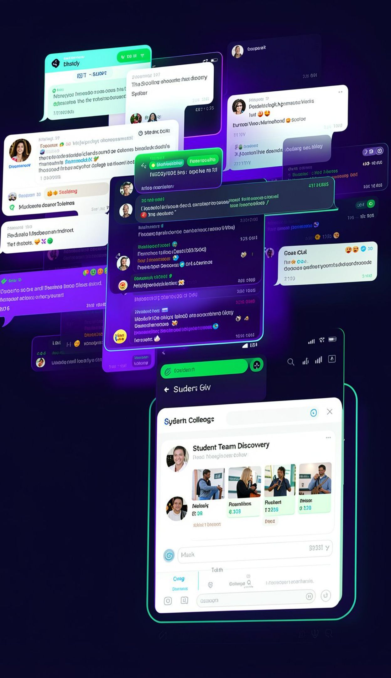
01 — THE PROBLEM
The Chaos of College Events
Finding the right teammates shouldn't be harder than building the project.
Communication Chaos
Skill Mismatch
Disorganized WhatsApp and Discord chats bury important invitations.
Teams form without understanding technical strengths, leaving gaps.
Unstructured Recruitment
Ghosted invitations and unclear roles create friction.
2

Slide 3



02 — THE SOLUTION
One Platform. Better Teams.
Replacing unstructured recruitment with intelligent team discovery.
Centralized Event Registry
Discover hackathons, college technical events, teams, and opportunities.
TEAMUP DASHBOARD
Find the event.
See the team.
Make the move.
Skill-Based Profiles
Mandatory technical skill tags make capabilities visible.
Events
Skills
Teams
Automated Team Management
Structured applications, status transitions, and organized recruitment workflows.
3

Slide 4
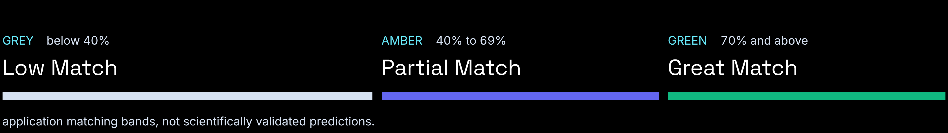
03 — MATCHING LOGIC
Smart Team Discovery
Find teammates through real-time mathematical skill compatibility scoring.
PROFILE A
PROFILE B
↔
Technical Skill Profile
Technical Skill Profile
REACT
NODE.JS
POSTGRESQL
REACT
EXPRESS
SUPABASE
Skills are visible before the invitation is sent.
Overlap creates a clearer starting point for teams.
COMPATIBILITY
4

Slide 5
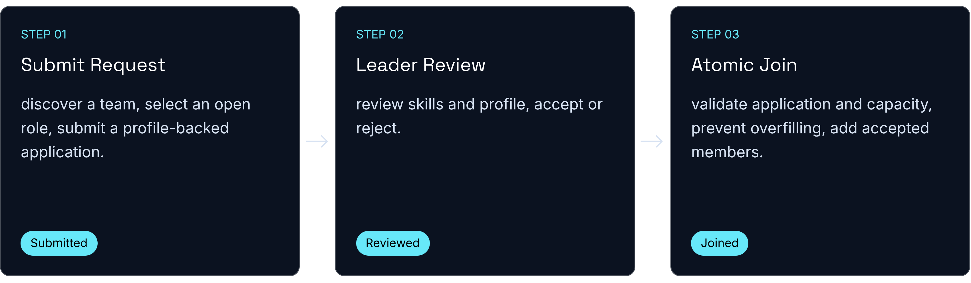
04 — APPLICATION PIPELINE
From Discovery to Team Formation
A structured application and approval pipeline.
5

Slide 6
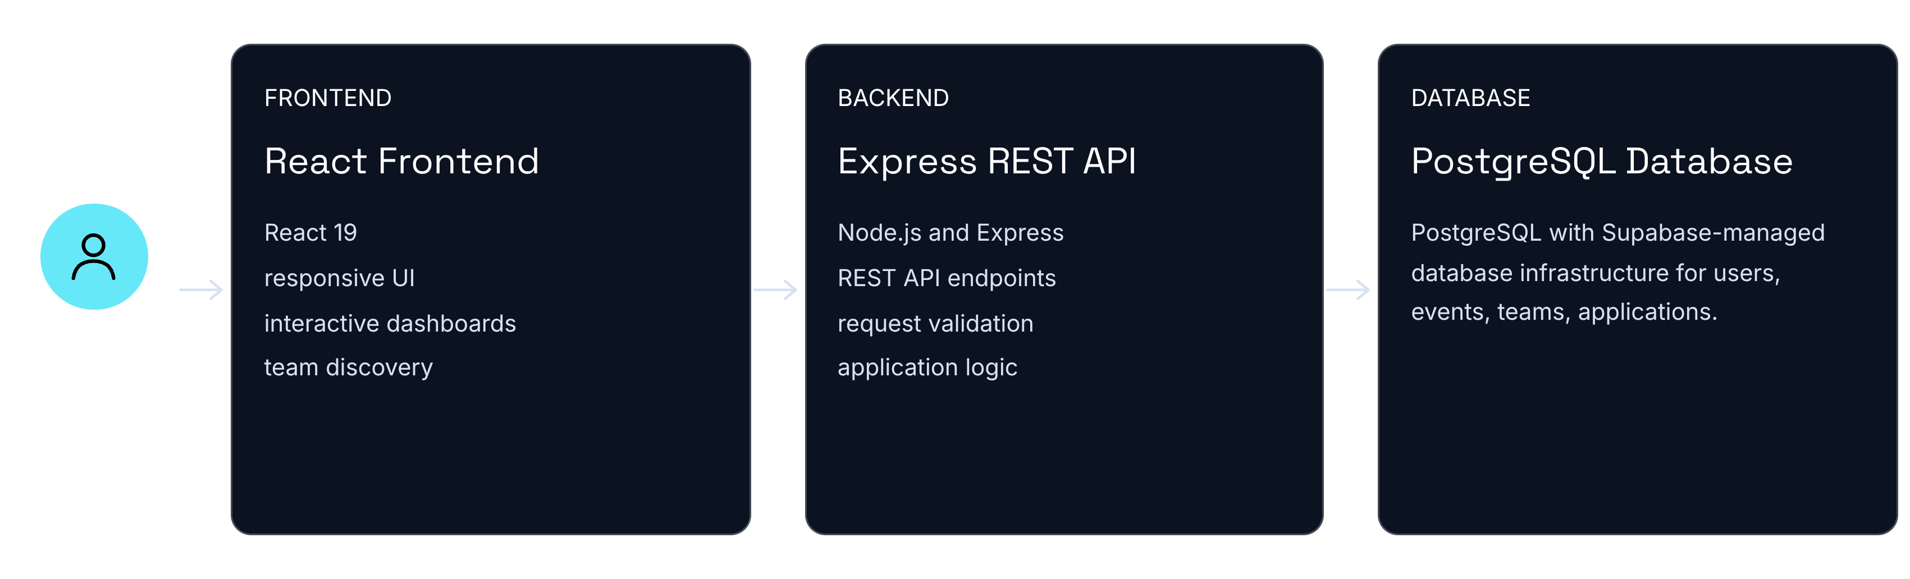
05 — SYSTEM DESIGN
Inside TeamUp
A modern full-stack architecture built for structured collaboration.
6

Slide 7


06 — TRUST LAYER
Control, Transparency & Communication
ADMIN VIEW
Keeping students and administrators connected.
Notifications
Events
Application accepted
Teams and activity
In-App Notification System
Admin Management Suite
Visible status. Fewer follow-ups. Clearer ownership.
Application updates, acceptance and rejection alerts, membership changes, and important team activity.
Faculty/admin control over events, platform usage, and event and team activities.
7

Slide 8
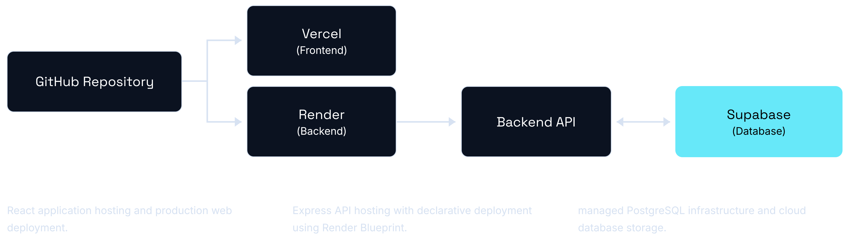
07 — DELIVERY
Built, Tested & Deployed
A cloud-based deployment architecture.
8

Slide 9
TEAMUP · NBKR INSTITUTE OF SCIENCE AND TECHNOLOGY
THANK YOU!
Build Better Teams.
Build Better Ideas.
Questions & Discussion
LIVE DEMO
SOURCE CODE
https://fsd-project-fawn-five.vercel.app/
https://github.com/Rohan-Balaji-007/fsd-project

